Slide 1


Remote Databases
SoftUni Team
Technical Trainers
Software University
http://softuni.bg

Slide 2
Table of Contents
Relational and Non Relational Databases
Backend as a Service - BaaS
Firebase
Using Firebase BaaS
Kinvey
Using Kinvey mBaaS

Slide 3
Have a Question?
sli.do #js-advanced

Slide 4



Relational Databases
Represent and store data in tables and rows
Use Structured Querying Language (SQL)
Allows you to link information from different tables through the use of foreign keys (or indexes)

Slide 5

Non Relational Databases
No-SQL databases
More flexibility and adaptability
Allow us to store unstructured data in a single document
Additional processing effort and more storage as the document sizes grow

Slide 6
Relational and Non Relational Pros
Relational
Work with structured data
They support ACID transactional consistency and support "joins"
Built-in data integrity and a large eco-system
Relationships in this system have constraints
Limitless indexing
Non Relational
They scale out horizontally
Work with unstructured and semi-structured data
Schema-free or Schema-on-read options
High availability
Many are open source and so "free"

Slide 7
Backend as a Service
Solutions that provide pre-built, cloud hosted components for developing application backends
Reduce the time and complexity required
Allow developers to focus on core features instead of low level tasks
Types:
Cloud BaaS
Opensource BaaS

Slide 8
Firebase
Real-Time Cloud DB and App Platform by Google

Slide 9
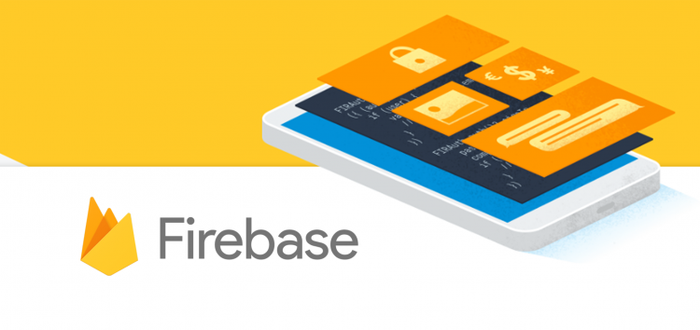
Firebase
Mobile and web development platform. It provides:
Realtime database
Backend as a service
JSON-based data structure

Slide 10
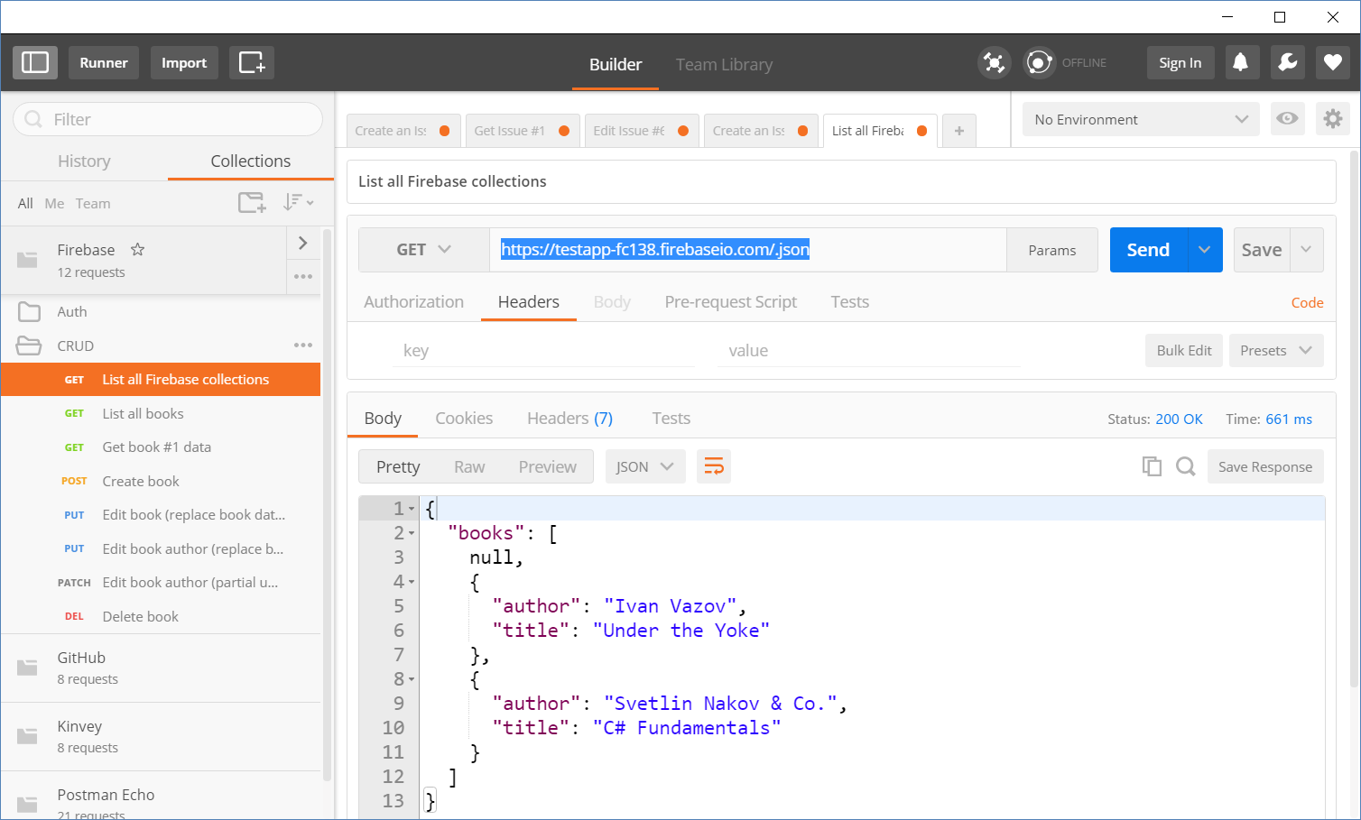
Accessing Firebase REST API with Postman
Append .json to your DB object URL

Slide 11
Firebase REST API - CRUD Operations
GET
https://testapp-fc138.firebaseio.com/.json
GET
https://testapp-fc138.firebaseio.com/books.json
GET
https://testapp-fc138.firebaseio.com/books/1.json
GET
https://testapp-fc138.firebaseio.com/books/1/author.json
POST
https://testapp-fc138.firebaseio.com/books.json
Body
{"title":"New title", "author":"New author"}
DELETE
https://testapp-fc138.firebaseio.com/books/6.json

Slide 12
Firebase REST API - CRUD Operations (2)
PUT
https://testapp-fc138.firebaseio.com/books/7.json
Body
{"title":"Edited", "year":1980, "ISBN":"954X"}
PATCH
https://testapp-fc138.firebaseio.com/books/7.json
Body
{"year":1981, "author":"Author Changed"}
PUT
https://testapp-fc138.firebaseio.com/books/7/author.json
Body
"New author was assigned"
DELETE
https://testapp-fc138.firebaseio.com/books/7/author.json

Slide 13
Authentication vs. Authorization
Authentication
The process of verifying the identity of a user or computer
Questions: "Who are you?", "How you prove it? "
Credentials can be password, smart card, external token, etc.
Authorization
The process of determining what a user is permitted to do on a computer or network
Questions: " What are you allowed to do?", "Can you see this page?"

Slide 14
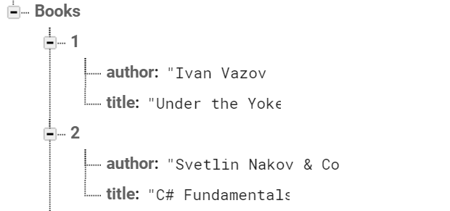

Firebase and Postman: All books
Open Firebase and create "TestApp" project
Create the following structure
Get all books by AJAX request

Slide 15
Firebase and Postman: Get Book
Using the recently created project in Firebase
Get the book with id: 1
Don't forget the .json extension at the end

Slide 16
Firebase and Postman: Create Book
To create a book in our Firebase project
Send a "POST" request
JSON body should be in the following format:
{
"title":"New title",
"author":"New author"
}

Slide 17

Kinvey
Collection-Based Cloud DB (mBaaS)

Slide 18


Kinvey as Back-End
Mobile Back-End as a Service (mBaaS)
Holds your app / mobile app data in the cloud
Hold users and user data
Users (API for creating an account)
Data collections (API for CRUD operations)
Files (upload / download / delete)

Slide 19
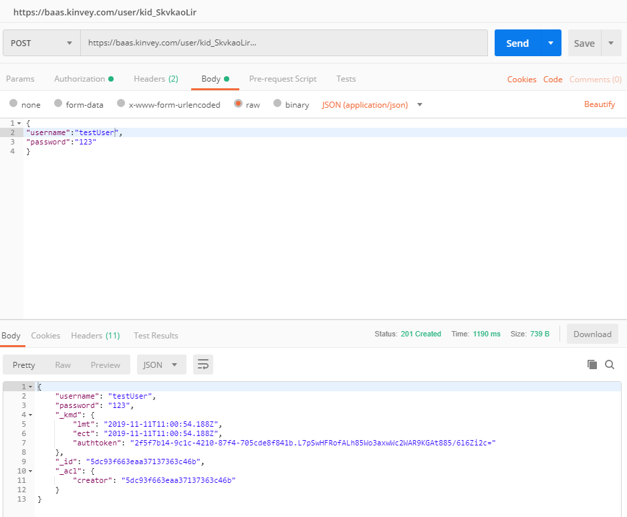
Kinvey and Postman: Register
URL: https://baas.kinvey.com/user/{app_id}
Method: POST
Authentication: Kinvey
User/pass: app_key : app_secret
Body:
Returns: authtoken
{"username":"…", "password":"…"}
"authtoken": "fd6d989d-0930-4c…wI="

Slide 20
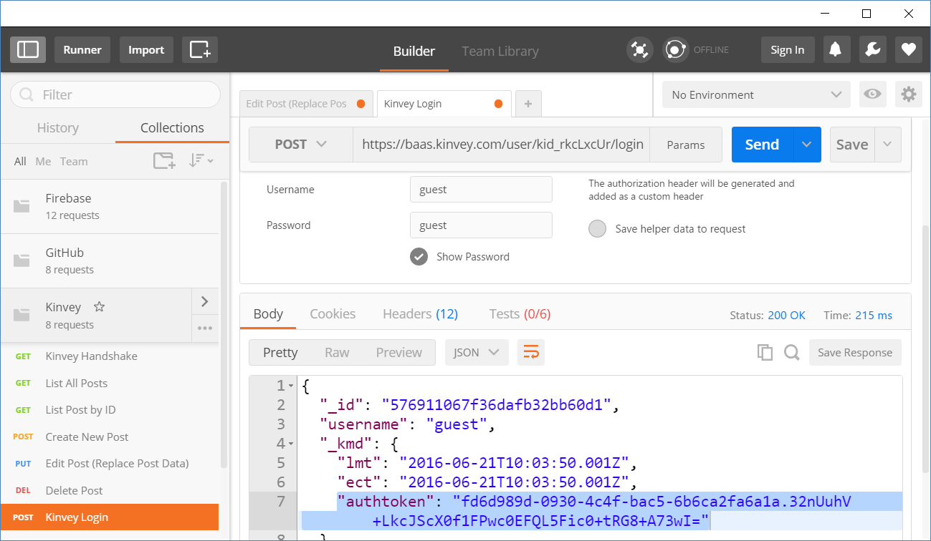
Kinvey and Postman: Login
URL: https://baas.kinvey.com/user/{app_id}/login
Method: POST
Authentication: Kinvey
User/pass: app_key : app_secret
Body:
Returns: authtoken
{"username":"…", "password":"…"}
"authtoken": "fd6d989d-0930-4c…wI="

Slide 21
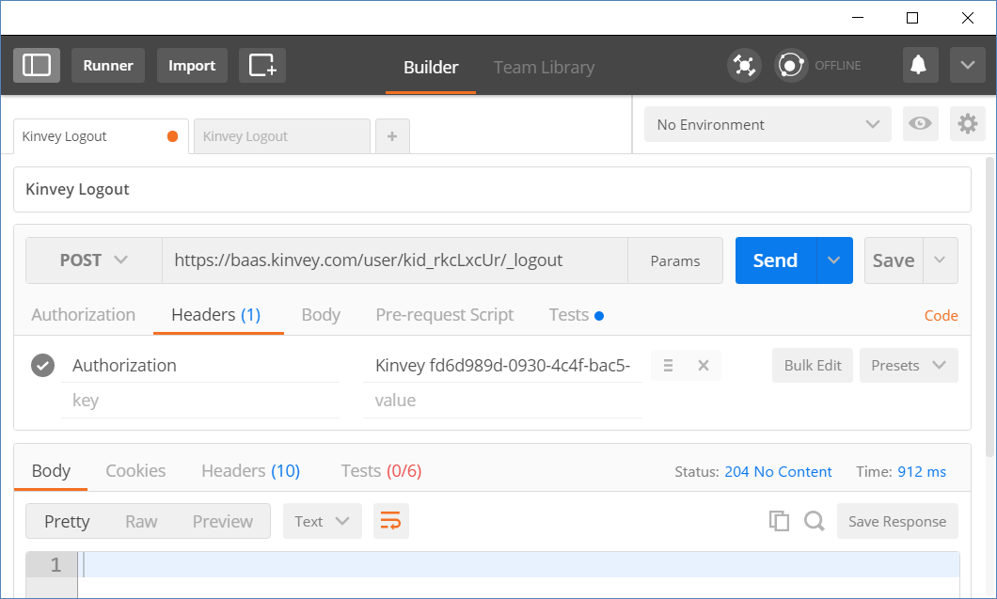
Kinvey and Postman: Logout
URL: https://baas.kinvey.com/user/{app_id}/_logout
Method: POST
Authorization:
Kinvey <authtoken>
Use the token given by the login request
Returns 204 No Content
Authorization:
Kinvey <authtoken>

Slide 22
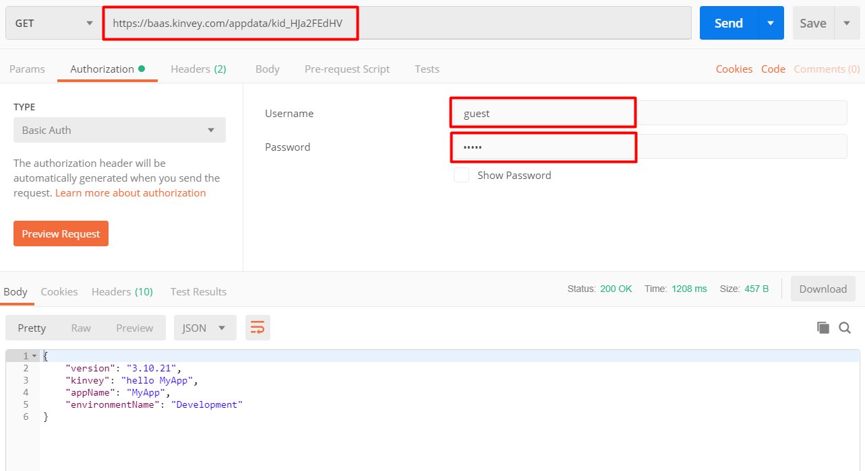
Test Your Backend with Postman
https://baas.kinvey.com/appdata/{app_id}
Basic authentication user: guest
pass: guest

Slide 23
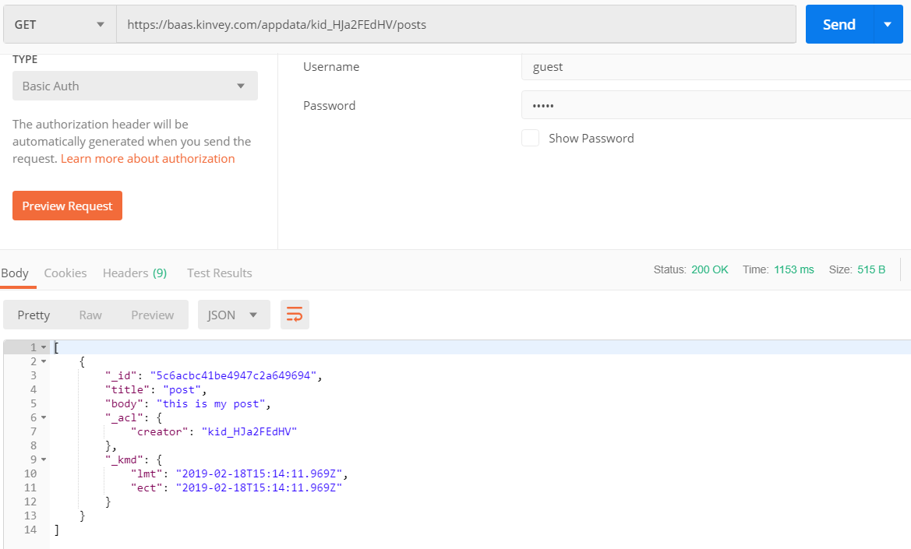
Kinvey and Postman: List All Posts
URL: https://baas.kinvey.com/appdata/{app_id}/posts
Method: GET
Authentication: Kinvey + token
User: guest
Pass: guest

Slide 24
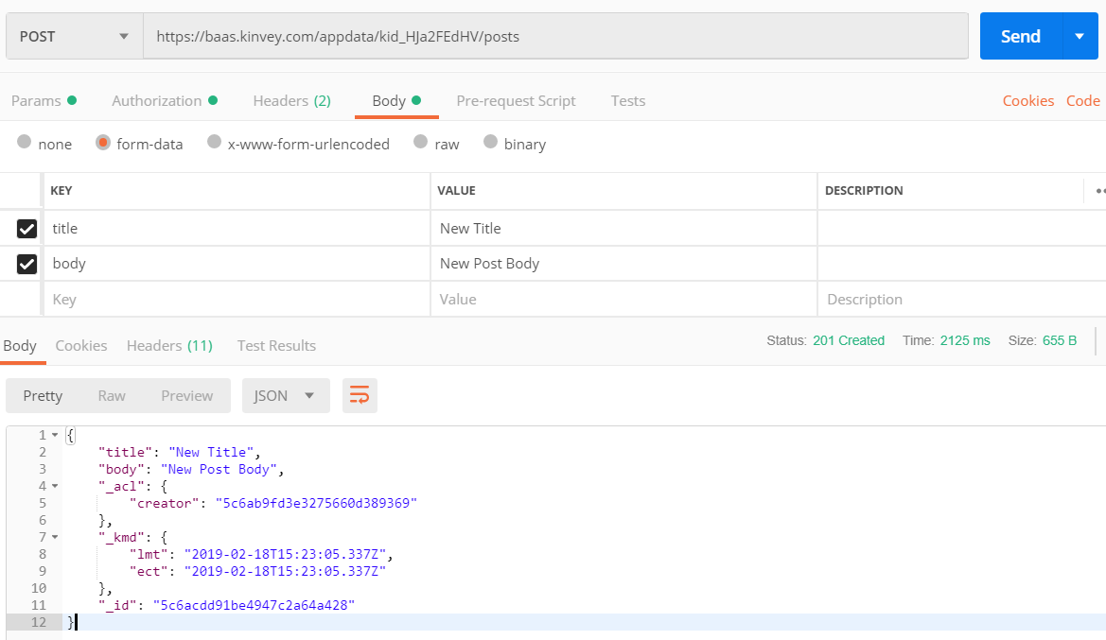
Kinvey and Postman: Create a New Post
URL: https://baas.kinvey.com/appdata/{app_id}/posts
Method: POST
Authentication: Kinvey + token
User / pass: guest / guest
Request body
title: New Title
body: New Post Body

Slide 25
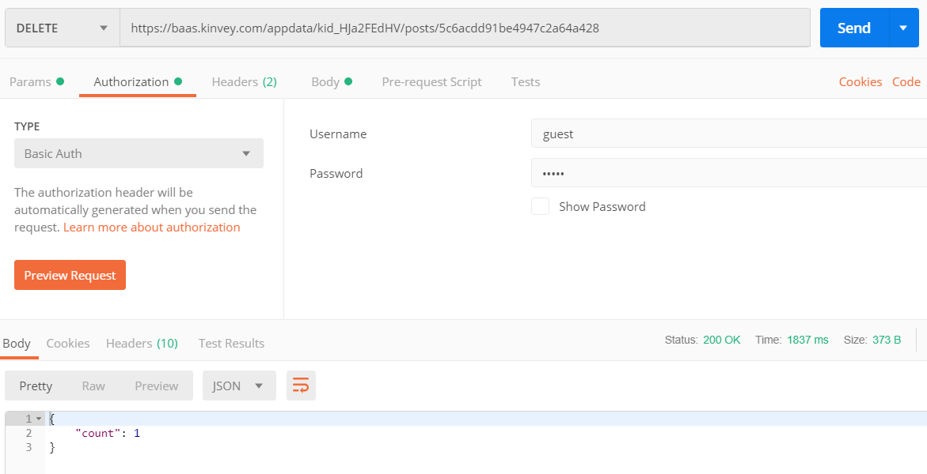
Kinvey and Postman: Delete an Existing Post
URL: https://baas.kinvey.com/appdata/{app_id}/posts/id
Choose an existing post's ID
Method: DELETE
Authentication: Kinvey + token
User / pass: guest / guest
Body: (empty)

Slide 26
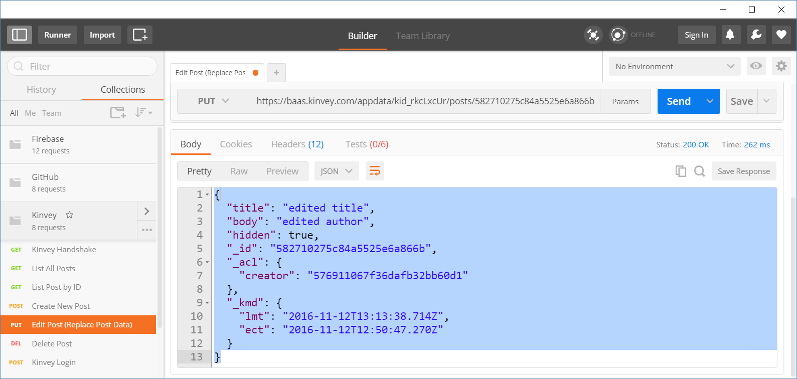
Kinvey and Postman: Edit an Existing Post
URL: https://baas.kinvey.com/appdata/{app_id}/posts/id
Choose an existing post's ID
Method: PUT
Authentication: Kinvey + token
User / pass: guest / guest
Body (JSON):
{"title":"edited title", "body":"edited author", "hidden":true}

Slide 27

Live Exercises

Slide 28
Summary
…
…
…
Relational Databases
Non Relational Databases
BaaS
Firebase is JSON-based cloud database
(mBaaS) with REST API
Kinvey is collection-based could database (mBaaS)

Slide 29
https://softuni.bg/courses/js-applications

Slide 30












SoftUni Diamond Partners

Slide 31




SoftUni Organizational Partners

Slide 32




Trainings @ Software University (SoftUni)
Software University – High-Quality Education and Employment Opportunities
softuni.bg
Software University Foundation
http://softuni.foundation/
Software University @ Facebook
facebook.com/SoftwareUniversity
Software University Forums
forum.softuni.bg

Slide 33

License
This course (slides, examples, demos, videos, homework, etc.) is licensed under the "Creative Commons Attribution-NonCommercial-ShareAlike 4.0 International" license

